Slide 1
Disease Detector
Diagnose diabetes being at home.
Group #3
Krisha Kocherla (0892897) Amisha Yadav (0862881)
Navya Nagaraj (0889675) Krunal Patel (0864443)

Slide 2
Contents
Introduction
Problem with current system
Objective
Advantages of proposed system
Briefing Diabetes
Modules of proposed system
Dataset & Algorithm
Working prototype
Problem with implemented system
Future enhancements

Slide 3
Introduction
A clinical decision-support system is any computer program designed to help medical professionals to make clinical decisions. It deals with clinical data and medical knowledge is intended to provide decision support.
It is easy to use for all genres like doctors, caretakers, nurses and patients.
It can be time effective.
Considering these advantages our projects deals with helping individuals by intaking their symptoms and outputting the results.

Slide 4

The problem
Need to take an appointment beforehand and to be present at specified time or even wait in queue.
Due to high consultancy many people avoid taking appointments and sometimes put themselves at risk without knowing the actual cause behind their symptoms.
Present Virtual diagnostic apps are not accurate enough to rely on it.

Slide 5

The solution
(Disease Detector)
Time effective solution to diagnose any conditions from anywhere at any time.
Diagnosis cost is reduced due to no commutation and consultation required.
Many people can be diagnosed at any given time

Slide 6

Mission statement:
To replace general doctors with human interactive interface to detect diseases(Diabetes) and to suggest the medical tests to confirm the results if user wants it.

Slide 7
Briefing Diabetes
Diabetes is a chronic disease in which the body either cannot produce insulin or cannot use the insulin (hormone that controls amount of glucose in blood) it produces.
Generic
Type 1
Type 2
Gestational
Retinopathy
Occurs when the body can’t properly use the insulin that is released or does not have enough produced insulin.
It is a chronic condition associated with abnormally high level of sugar in the blood
Occurs when the immune system fallaciously attacks and kills the beta cells of pancreas
It occurs during pregnancy when the body cannot produce enough insulin to handle the effects of a growing baby and changing hormone level.
Occurs to the retina due to diabetes mellitus and leads to blindness.

Slide 8
Usable by anyone
To get suggestions about their conditions
Modules
Usable by Hospital staff
To get report based on the result of the tests
Module 1
Module 2

Slide 9

Technology used:
.Net (MVC) MS SQL JQuery Bootstrap
Dataset :
Kahn, M. (2018). UCI Machine Learning Repository: Diabetes Data Set. [online] Archive.ics.uci.edu. Available at: https://archive.ics.uci.edu/ml/datasets/diabetes [Accessed 14 Oct. 2018].

Slide 10
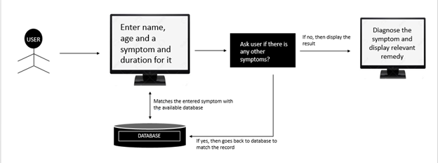
How it works (DFD) (Module 1)

Slide 11
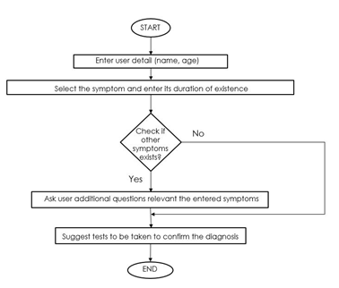
Flowchart
(Module 1)

Slide 12
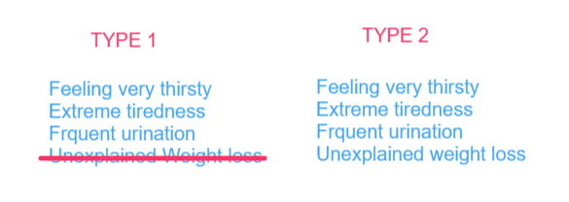
Get to know it better

Slide 13

Get to know it better
Working model

Slide 14
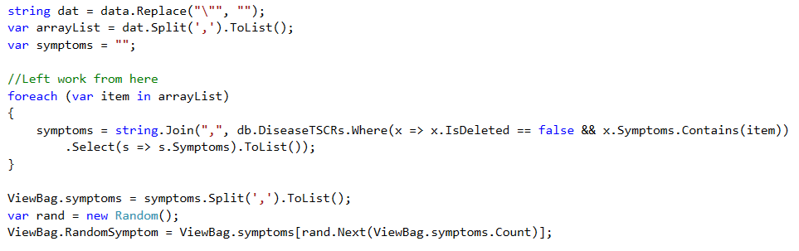
Server logic to continually ask symptom questions
Application sends selected symptom to server
Server matches and will fetch the disease which has the same symptom which is selected
Return random symptom to get the precise prediction

Slide 15
Server logic to predict the disease
Will return the disease name that have the same symptoms with it.
We will make rule depending on the datasets and based on that rule we will train our system to get desired output.

Slide 16
Problem with implemented system
User Needs to select from large list of symptoms that are available. Which is somewhat inconvenient and unreliable to get accurate results.
Not reliable enough.
Cannot predict if the user has some other symptoms related to diabetes which is not present in database.

Slide 17

Further enhancements
Generating & implementing rules to predict the disease with at least 75% of accuracy
Try to implement Machine learning algorithm to fetch accurate symptoms from user & to truly understand the users situation
Will work on Module 2

Slide 18
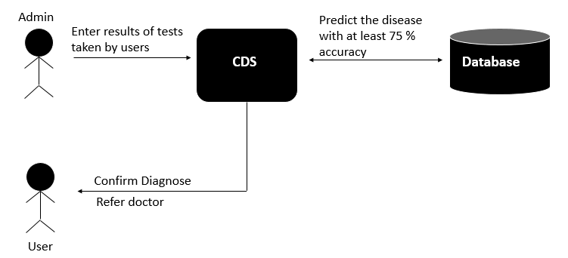
How it will work (DFD) (Module 2)
User takes suggested
tests at hospitals

Slide 19
References
Kahn, M. (2018). UCI Machine Learning Repository: Diabetes Data Set. [online] Archive.ics.uci.edu. Available at: https://archive.ics.uci.edu/ml/datasets/diabetes [Accessed 14 Oct. 2018].
Chui, Kwok, Wadee Alhalabi, Sally Pang, Patricia Pablos, Ryan Liu, and Mingbo Zhao. "Disease Diagnosis in Smart Healthcare: Innovation, Technologies and Applications." Sustainability 9, no. 12 (2017): 2309. doi:10.3390/su9122309
Github Url : https://github.com/KrunalPatel2194/ClinicalDicision

